Slide 1
COOLING FAN PCB PROJECT
For Textron Aviation Members: Ayham Sabra, Cody White, Melvin St. John

Slide 2
PROJECT DESCRIPTION
The goal of this project is to develop a circuit that will monitor the tachometer output of a brushless DC cooling fan and provide an output indicator to the pilot as to the fans operational status.

Slide 3
REQUIREMENTS/CONSTRAINTS
Environmental Requirements:
Operable within -55 to 85 degrees Celsius
Operable in altitudes from -1000 ft to 55,000 ft.
Ensure it follows DO 160G sections 6, 8, and 22
Humidity, Vibration, and Indirect effects of lightning
Design Constraints:
Design should not utilize programmable parts as it would require additional testing.
Use only generic easily source-able parts to avoid obsolescence issues
Circuit must fit within a package sized: 0.5 x 0.5 x 1.5 inches
Design must have minimal impact to the aircraft/maintenance crew.

Slide 4
REQUIREMENTS/CONSTRAINTS CONT.
Input Constraints:
Powered by a 28 Vdc bus, but must operate reliably within 10 - 80 Vdc
Tach signal must be filtered to avoid unnecessary triggering issues
Tach will provide a 0-5 Vdc or 0-28 Vdc Square wave (application dependant)
Output Constraints:
Should provide a discrete output
Output should go to ground when the fan’s RPM is ABOVE a defined threshold and must be able to sink 1 amp continuously when providing ground
Otherwise, the output should provide an open (high impedance) output if the tach input frequency is LESS than the defined threshold minus a hysteresis value; the intent of the hysteresis is to ensure the Indicated output does not oscillate whenever the tachometer input frequency is operating at, or near, the defined threshold frequency.

Slide 5
Deliverables
PCB Schematic files
PCB Layout files
Package design files
Project report
Detailed functional description
Instructions of how to set the frequency threshold and hysteresis parameters for different applications
Results from testing that was accomplished to prove out the design.

Slide 6
FLOW CHART OF DESIGN
Tachometer Input
Initial Filtering
PMW implemented by NE555 Timer
MOSFET open collector output
Schmitt Trigger to compare average DC value to reference voltage
Sallen Key Filter to average out the voltage to DC value
Power Bus Input
TVS and Linear Voltage Regulator
Vcc and ground for any active components

Slide 7

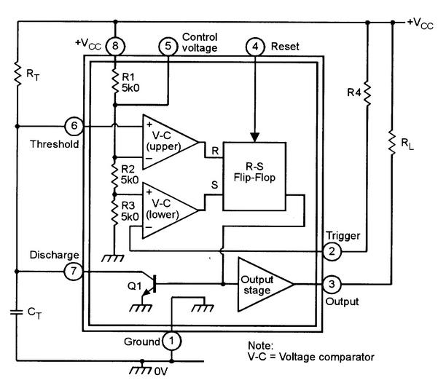
555 TIMER
Non-retriggerable Monostable Multibvibrator
Vout would be high (Vcc)
Trigger voltage must be low (less than Vcc/3). Threshold voltage must be low (less than 2Vcc/3).
Vout will switch to low (ground)
Trigger voltage must be high (great than Vcc/3). Threshold voltage must be high (great than 2Vcc/3)
Threshold voltage is the voltage across capacitor CT (see next slide)
Time period of on cycle can be calculated with formula T = 1.1RC

Slide 8
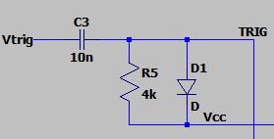
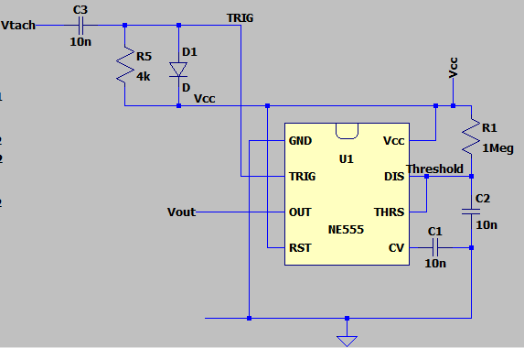
Differentiator
Differentiator
Differentiator (high pass filter) is used for our trigger voltage. The use of a differentiator allows the signal to be low only at the falling edge (and a little after due to discharge)
Vcc is used instead of ground to shift the signal up
Diode is used to clip leading edge differentiation (would lead to a voltage of 2Vcc which could damage 555 timer chip)

Slide 9
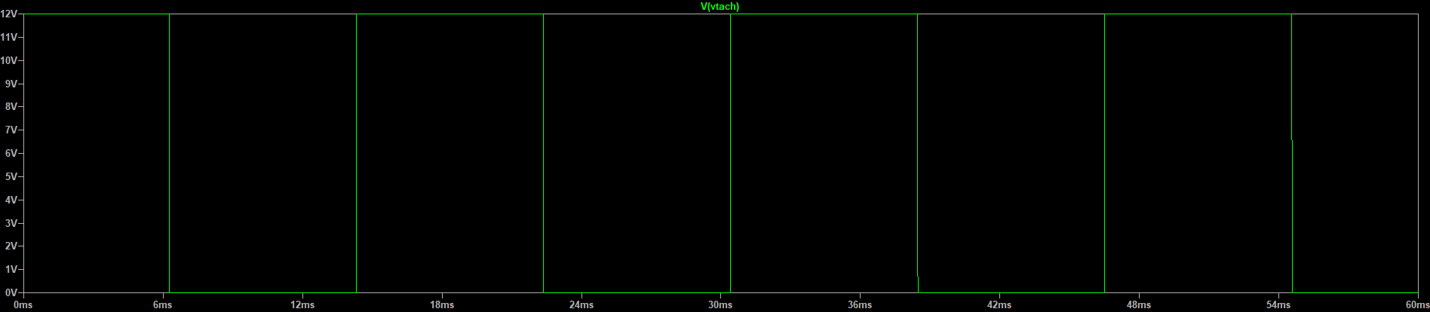
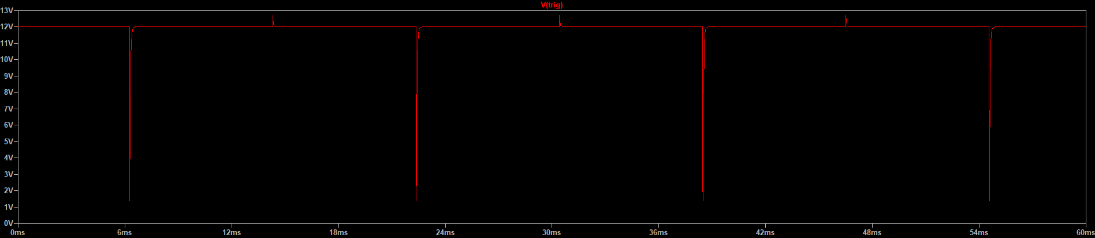
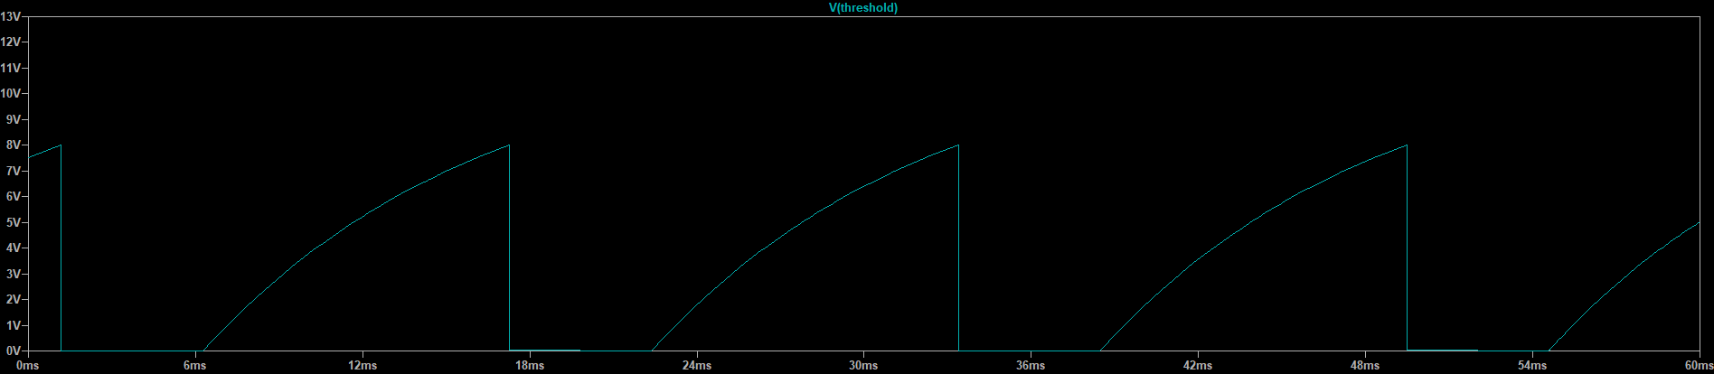
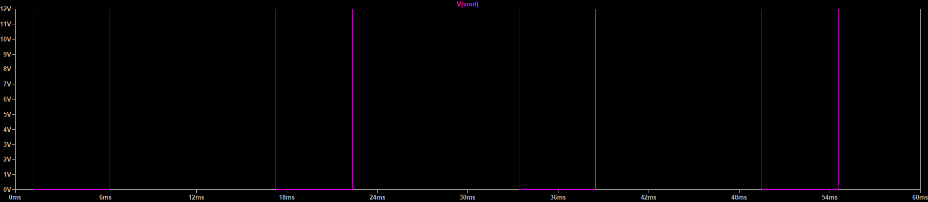
Differentiator and Monostable Multibvibrator
Tachometer voltage
Trigger voltage
Threshold voltage
Output voltage

Slide 10
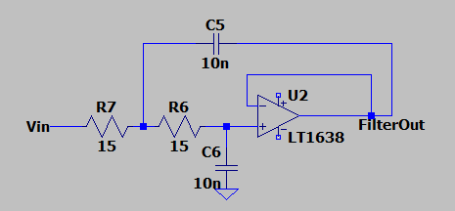
SALLEN KEY FILTER
Initial Low Pass
RC circuit that cuts off the high frequencies in a signal.
Used to offset the slower slew rate of the Op-amp in later stages
Sallen Key Filter
Active filter that incorporates an Op-amp as the active component as well as passive elements: resistors and capacitors.
At low frequencies C5 and C6 act as open ckts. ; signal buffered to O/P
At high frequencies C5 and C6 act as short ckts.;
Signal is shunted to ground at OP-AMPs i/p

Slide 11
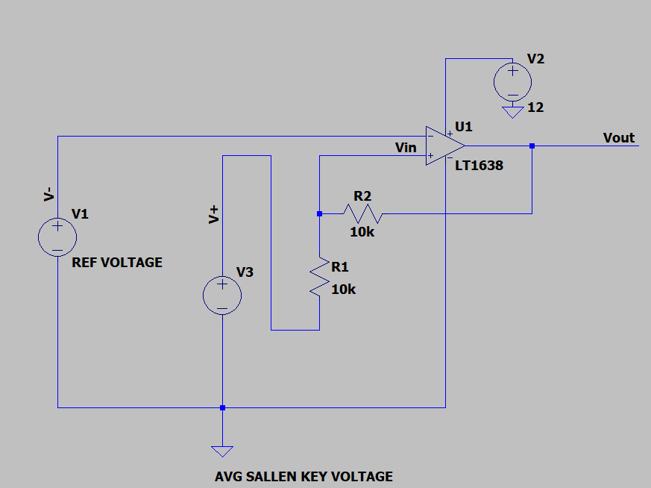
SCHMITT TRIGGER
Comparator to reference voltage
Positive Hysteresis Feedback to the non inverting terminal of the op-amp
When i/p is higher than upper threshold,
o/p will be high
When i/p is lower than the lower threshold,
o/p will be low.
Hysteresis allows fo the dual threshold action; this
Gives a sort of pseudo memory and it can
Act as a sort of flip flop.

Slide 12
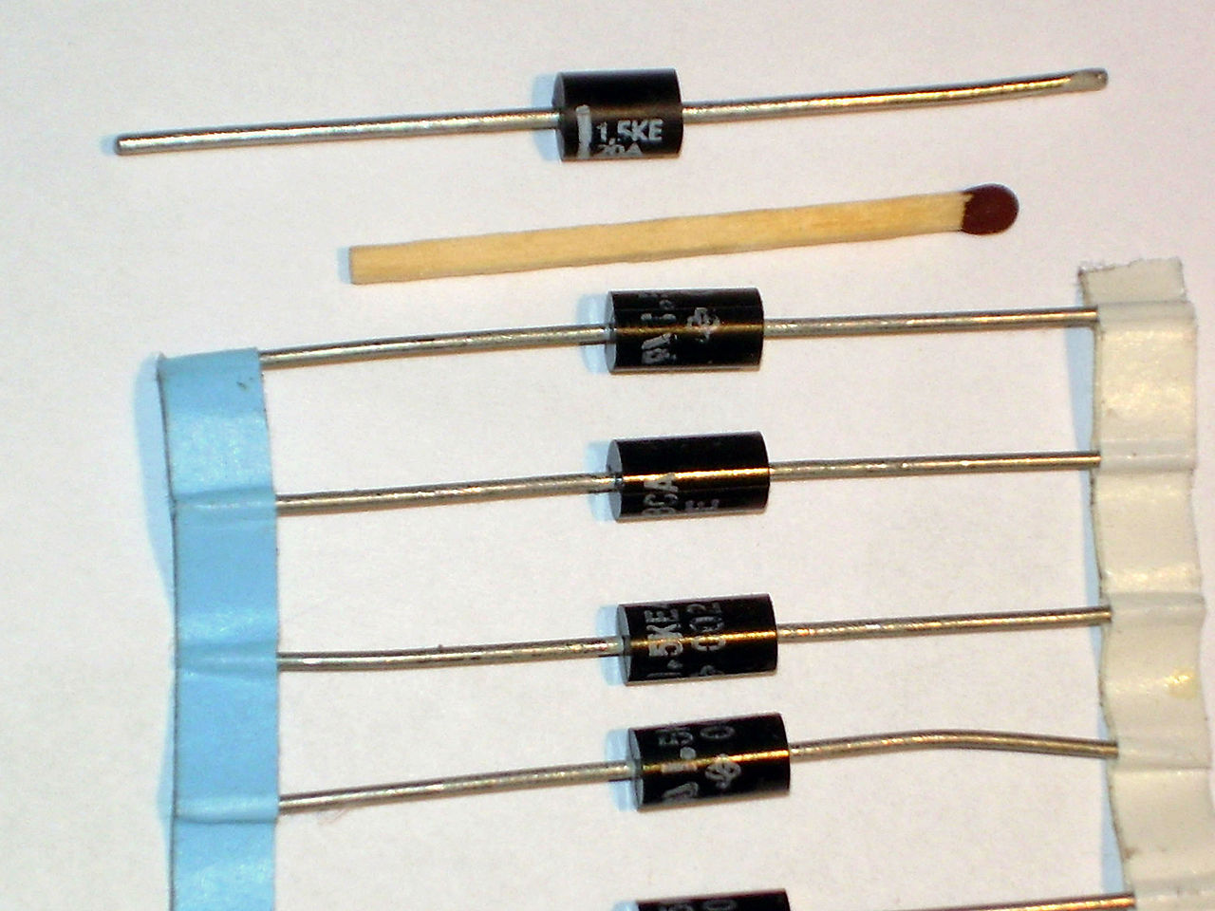
LIGHTNING PROTECTION
TVS
TVS (Transient Voltage Suppression diode) have similar characteristic to zener diode
TVS are used for transients from indirect effects of lighting protection.
When transients from indirect effects of lighting do occur, the TVS will stun current from the transient to ground. It will also set voltage across it to its break down voltage
Best to select TVS with break down voltage above normal voltage across TVS as to have TVS off the majority of time, and only on during transients from indirect effects of lightning.
MOSFET
Textron provided us MOSFET that will protect against indirect effects of lightning

Slide 13
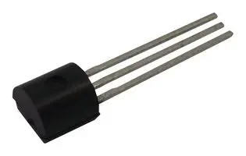
VOLTAGE REGULATION
Linear Voltage Regulator
We will be using a IC chip voltage regulator
There will be a TVS just before the voltage regulator
We will have to be careful in selecting the IC for this voltage regulator
Make sure it is an industry standard that will likely never go obsolete
Make sure it is rated for TVS breakdown voltage (or at very least 80V)

Slide 14
CITATIONS
NE555
https://www.nutsvolts.com/magazine/article/555-monostable-circuits
TVS
https://en.wikipedia.org/wiki/Transient-voltage-suppression_diode#/media/File:Transils-01.jpeg
Voltage Regulator
https://il.farnell.com/stmicroelectronics/l78l05abz/ic-reg-ldo-5v-100ma-to-92/dp/1564312

Slide 15
https://www.youtube.com/watch?v=_R5slYda2vc
https://teams.microsoft.com/l/meetup-join/19%3ameeting_NWEwY2NmNzQtMDk5Zi00ZTE1LTg0YjMtNTRlZGU0YmIxMmRi%40thread.v2/0?context=%7b%22Tid%22%3a%22e05b6b3f-1980-4b24-8637-580771f44dee%22%2c%22Oid%22%3a%22044d0e61-d7b0-454a-ade1-eac4aa6d7230%22%7d

